Slide 1
PyData Array Recommendations
Thomas Dimitri

Slide 2
Background
30+ years professional software engineer – network protocols, user interfaces, compilers, file formats, pci cards, bios, trading engines, scanners, architectural software, ran 2 software companies, software patents, c/c++, java, c#, python
14 year consultant for SIG currently tasked with unifying large data analytics and framework
SIG has Matlab, Python (numpy, pandas), C++/C# algos
Desire to move towards one platform over time
Ongoing beta solution: riptide: Uses Datasets/Structs/NumpyArrays, Multithreaded Numpy, portable FileFormat with stacking

Slide 3
Array Recommendations (in order of importance)
Multithread back end engine and separate out to portable ‘C’ lib
Introduce multikey Categorical class, subclassed from two classes Array and GroupingOps
Introduce Grouping and GroupingOps class
New loops: groupby loops/ partition loops/ closer JIT coupling
Introduce new apis (hashing) + Invalids
Subclass before making another dtype: Rework Date/Time classes
Ledger + other ways to analyze performance
Dtypes for variable length string: ucs1,2,4. Bitmask.
Hooks for display/storage/setname/getname

Slide 4
Threading Model
Thread at Top
User code, DataFrame, layer
Java, C#,
Rust, Julia, R, Matlab,
C, C++
Can Also use
Python Front End Parsing
i.e. np.add(arr, 5)
X = arr+5
isarray, isscalar,
col/row major, strides, casting, broadcast, GIL handling, etc
dll/so/lib c api
portable multiplatform multithread
c api
Thread at Bottom
ufunc = lookup_ufunc(
func_enum, dtypeIn, &dtypeOut)
binary, unary, sort, convert, mask, etc.
ufunc(pIn, pOut, len, strideIn, strideOut)
128bit lib
256bit lib
512bit lib

Slide 5
Threading Model for Arrays
Multicore/Shared memory same computer, same process
Possible tuning: Thread count, NUMA, Process Affinity
Wakeup (futex) – important: selective thread wake up
Some routines just need 2 worker threads, more threads is not going to speed anything up for absolute value. Memory bound problem.
Calibration of worker threads
Array Recycling (when large page allocations disabled - for speed to reduce page faults)
NOTE: Distributed/Cloud Computing (not covered)

Slide 6
Portable Multithreaded C (Orange Block)
Gold Standard and easy to achieve with interface decoupling
Allows other platforms or languages to call same routines with same results and performance
Prefer C interface over C++ (a C++ layer can wrap C interface)
In many low level routines want to get sum of Boolean mask (np.add.reduce(mask)) – should really just call SumBoolean()
Threading while threading (have to know inside threaded routine)
Be able to turn on “Ledger” to see what is getting called, performance

Slide 7
Array Routines We Threaded
Basic Math both Unary and Binary (abs, add, sqrt, etc.)
Comparisons (==, !=, <, >, <=, >=)
Casting Conversions (i.e. int32 to float64)
Boolean mask, Fancy Index mask set/get (i.e., a = b[filter])
Reduce: all reduce functions sped up
Sorting (espec lexsort, multithreaded multikey indirect merge sort)
putmask, where, searchsorted, hstack, interp
+ Added Hashing, ismember, group creation

Slide 8
Speed ups from multi-threading
Varies from 1.5x to 30x speedups (large arrays)
Some users thread at top (with multiple processes), and use 2 threads at bottom for maximum performance
Most basic math sped up by 3x
Some reduction functions like sum,min,max,std up to 30x
Unary functions sped up (isnotnan 10x faster than ~np.isnan())
Many comparisons sped up by 10x
getitem[fancyindex] sped up by 20x
Can always turn off – thus no harm from multithreading

Slide 9
Example dir of FastArray which subclasses np.ndarray (inherits)
FastArray
'abs','all','any','apply','apply_numba','argmax','argmin','argpartition','argpartition2','argsort','astype',
'base','between','byteswap','choose','clip','clip_lower','clip_upper','compress','conj','conjugate','copy','copy_invalid','count',
'crc','ctypes','cummax','cummin','cumprod','cumsum','data','describe','diagonal','diff','differs','display_query_property',
'dot','dtype','dump','dumps','duplicated','ema_decay','fill','fill_backward','fill_forward','fill_invalid','fillna','flags','flat',
'flatten','get_name','getfield','imag','info','inv','iscomputable','isfinite','isin','isinf','isna','isnan','isnanorzero',
'isnormal','isnotfinite','isnotinf','isnotnan','isnotnormal','issorted','item','itemset','itemsize','map','map_old','max','mean',
'median','min','move_argmax','move_argmin','move_max','move_mean','move_median','move_min','move_rank','move_std','move_sum',
'move_var','nanargmax', 'nanargmin','nanmax','nanmean','nanmin','nanrankdata','nanstd','nansum','nanvar','nbytes','ndim',
'newbyteorder','nonzero','normalize_minmax', 'normalize_zscore','notna','numbastring','nunique','partition','partition2','prod','ptp',
'push','put','rankdata','ravel','real','register_function','repeat','replace','replacena','reshape','resize','rolling_mean','rolling_nanmean',
'rolling_nanstd','rolling_nansum','rolling_nanvar','rolling_std','rolling_sum',
'rolling_var','round','sample','save','searchsorted','set_name','setfield','setflags','shape','shift','sign','size','sort',
'squeeze','std','str','str_append','strides','sum','swapaxes','take','tile','timewindow_prod','timewindow_sum','tobytes','tofile',
'tolist','tostring','trace','transitions','transpose','trunc','unique','var','view','where'
Note the added functionality for display (get_name, set_name, display_query)

Slide 10
Categorical Class (not a new dtype)
Subclasses from (FastArray, GroupByOps)
Base array is int8/16/32/64
Take most common categorical, of single string array
mycat=Cat(stringarray)
Often looks like string, sometimes integer bins
We chain ._fa or _.np to view FastArray or np.ndarray if we want to force integer bin mode
Can chain .str for string or .date for Dateclass to
Creation can take two paths:
Via a lexsort or hashing
hashing (faster for low cardinality), also preserves order of first occurrence
Once uniques are discovered, the high/low unique ratio count known important for some algorithms
Have to be able to filter out (we reserve 0) so base 1 indexing

Slide 11
Categorical Class
Example: 3 key categorical
Cols act like
fused together
Data
__new__ built from 3 keys
{‘symbol’: sym, ‘date’: dt, ‘volclass’: volcat}
holds unique_dict
unique_dict
main class
holds grouping
Grouping
object
unique row
AAPL, 5/20, 34.55
Cat
Methods
ifirstkey
to make unique_dict
int
arr
the
bin
#
ikey
instance is ikey
must be equal row length
Array
Methods
subclassed
ifirstkey
igroup to reorder ikey
to ‘sort’ groups
GroupingOps
Methods
ncountgroup
igroup
igroupreverse
to go back

Slide 12
Categorical has Grouping object also inherits from GroupingOps
Grouping object:
'apply','apply_helper','as_filter','base_index','catinstance','copy','copy_from','count','gbkeys','get_name','ifirstgroup','ifirstkey','igroup',
'igroupreverse','ikey','ilastkey','inextkey','iprevkey','iscategorical','isdirty','isdisplaysorted','isenum','isin','ismember','ismultikey','isordered',
'isortrows','issinglekey','ncountgroup','ncountkey','newclassfrominstance','newgroupfrominstance','onedict','pack_by_group','packed',
'possibly_recast','register_functions','regroup','set_dirty','set_name','shrink','sort','unique_count','uniquedict','uniquelist’
dir of Categorical class (inherits from FastArray and GroupingOps)
'abs','agg','aggregate','align','all','any','apply','apply_nonreduce','apply_numba','apply_reduce','argmax',
'argmin','argpartition','argpartition2','argsort','as_filter','as_singlekey','as_string_array','astype','auto_add_off','auto_add_on','base','base_index','between',
'byteswap','categories','categories_equal','category_add','category_array','category_codes','category_dict','category_mapping','category_mode',
'category_remove','category_replace','choose','clip',
'clip_lower','clip_upper','compress','conj','conjugate','contains_np_arrays','copy','copy_invalid','count','count_uniques','crc','ctypes','cumcount',
'cummax','cummin','cumprod','cumsum','data','describe','diagonal','diff','differs','display_convert_func','display_query_properties','doc','dot',
'dtype','dump','dumps','duplicated','ema_decay','ema_normal','ema_weighted','expand_any','expand_array','expand_dict','fill','fill_backward','fill_forward',
'fill_invalid','fillna','filter','filtered_name','filtered_set_name','filtered_string','findnth','first','first_bool','first_fancy','flags','flat','flatten',
'from_bin','from_category','gb_keychain','get_groupings','get_header_names','get_name','getfield','groupby_data','groupby_data_clear',
'groupby_data_set','groupby_reset','grouping','grouping_dict',
'groups','head','hstack','ifirstkey','ikey','ilastkey','imag','info','inv','invalid_category','invalid_set','iscomputable','isenum',
'isfiltered','isfinite','isin','isinf','ismultikey','isna','isnan','isnanorzero','isnormal','isnotfinite','isnotinf','isnotnan','isnotnormal',
'issinglekey','issorted','item','itemset','itemsize','iter_groups','key_from_bin','last','lock','map','map_old','mapping_add','mapping_new',
'mapping_remove','mapping_replace','max','mean','median','min','mode','move_argmax','move_argmin','move_max','move_mean','move_median','move_min',
'move_rank','move_std','move_sum','move_var','nan_index','nanargmax','nanargmin','nanmax','nanmean','nanmedian','nanmin','nanrankdata','nanstd',
'nansum','nanvar','nb_ema','nb_min','nb_sum','nb_sum_punt','nbytes','ndim','newbyteorder','newclassfrominstance','ngroup','nonzero','normalize_minmax',
'normalize_zscore','notna','nth','null','numbastring','nunique','ohlc','one_hot_encode','ordered','partition','partition2','prod','ptp',
'push','put','rank','rankdata','ravel','real','register_function','register_functions','repeat','replace','replacena','resample','reshape','resize',
'rolling_count','rolling_diff','rolling_mean','rolling_nanmean','rolling_nanstd','rolling_nansum','rolling_nanvar','rolling_shift','rolling_std','rolling_sum','rolling_var','round',
'sample','save','searchsorted','sem','set_name','setfield','setflags','shape','shift','shift_cat','shrink','sign','size',
'sort','sort_gb','sorted','squeeze','std','str','str_append','strides','sum','swapaxes','tail','take','tile',
'timewindow_prod','timewindow_sum','tobytes','tofile','tolist','tostring','trace','transform','transitions','transpose','trimbr','trunc','unique',
'unique_count','unique_repr','unlock','var','view','where'

Slide 13
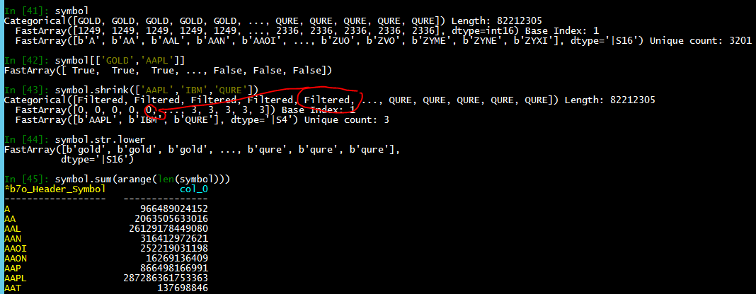
Cat example with filter and GroupingOps
example str Cat
isin filter
can trim
very fast str ops
has groupbyops

Slide 14
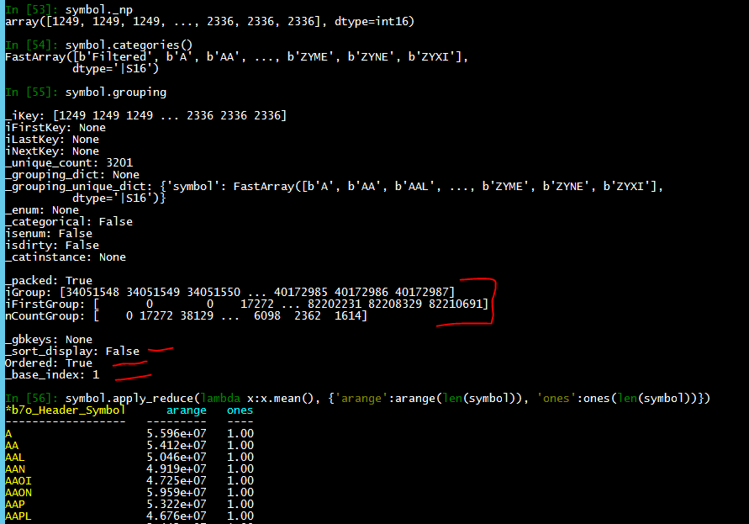
Cat example with base array, grouping, reduction
can flip view
get uniques
Grouping object
igroup is fancy index
igroup + ncountgroup needed for grouping loop
has apply power

Slide 15
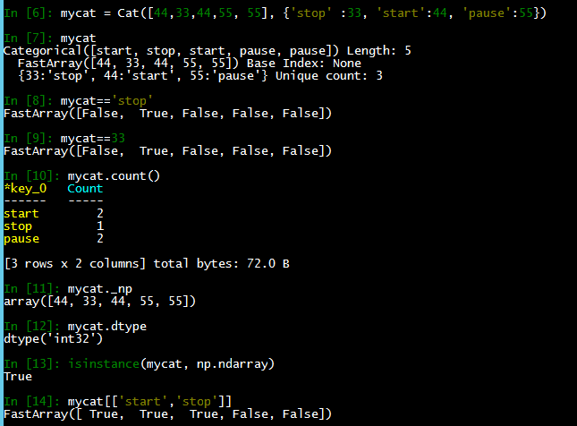
Enum Cat Example (pre defined bins)
User has predefined bins
Wants to see 33 for ‘stop’
Duality: can use strings
Duality: can use int
Has same functionality as
normal categorical
user bin referenced, not copied
subclasses from np.ndarray
isin and other functionality works

Slide 16
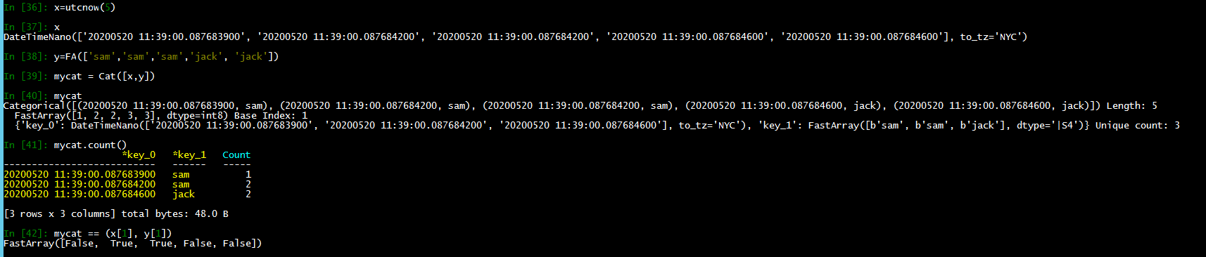
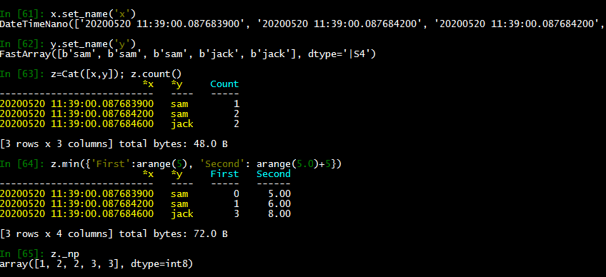
Multikey Cat Example (Date + String) Can have many keys, ordered or not
ez to create multikey
still uses int bin
use tuple to lookup
arrays needs names
now names correct
groupops functionality
int8/16/32/64
based on uniq count

Slide 17
Common Categorical Operations
Categoricals can
Be compared to one another
Add, Remove, Edit, Reorder, Regroup uniques
Filtered (reserve 0, base 1 indexing)
Saved and Loaded
Convert from multikey to single key
Revert back to original array construction
Multiple categoricals can be Stacked
Be created from one or more other categoricals
Can be ordered in various ways: lexigraphical/first appearance

Slide 18
Grouping and GroupingOps class
Contains common routines that users like to perform over groups
Reduce functions such as sum, min, max
Cumulative such as cumsum, cumprod
Rolling or sliding windows, moving averages (ema functions)
Repopulating original array after a reduce function (e.g. ‘transform’)
Any operation performed over a single array, can be performed over a group of single arrays
Custom functions or lambda functions which can be jitted
Allowing multiple functions (from above) to be applied in one command
Contains helper arrays:
Have fancy index helpers:
ifirstkey –an array of row numbers where first member of group appeared
ilastkey – where last member of group appeared
igroup – a fancy index which when applied, would reorder groups contiguously
igroupreverse – fancy index to get reverse igroup
Other arrays
ngroupcount (how many items in the group)
more

Slide 19
New Loops
Existing:
Contig math vector loops (stride == itemsize)
Able to hit mm_256_add_ routines, etc.
Strided loops
Can also use vector routines via gather intrinsic
New: Groupby Loops
See “igroup” – fancy index in order of uniques
For example if ‘AAPL’ is first category then it might exist in 10,000 rows scattered about 1 million row array. Similar to what lexsort returns now to sum up all ‘AAPL’ can just use the index to get to the data (no need to copy or reshuffle data)
New: Partition Loops
Often used after sort_inplace. Now groups are in order – might be many groups, perhaps 1 million… want to ‘fake’ slice arrays fast to do operations (real slice too much overhead)
Loop over JIT kernels
Numba has nb.prange and threads.. Can use that to create own grouping kernel

Slide 20
Suggested Additions to Array
Hashing Class
Example “groupbyhash” and ismember
Many hashing algos – we use linear probing hash
Also quadratic hash, robin hood, cuckoo, etc, + red/black tree
Or crc, “smarthash”, “murmur”, and many others
Like np.add.reduce… np.hash.reduce
What is fast way to drop_duplicates? hash
Find out if all the unique categories are the same? hash
Searchsorted with kwarg ‘exact’
Must be exact match or give other index, like -1
Searchsorted is easily multithreadable, thus it can be used in ismember
Merge variations
Enrichment style
Left/Right Inner/Outer Join
Think about isnot routines like isnotnan very popular
Other ideas like fma (fused multiply add)

Slide 21
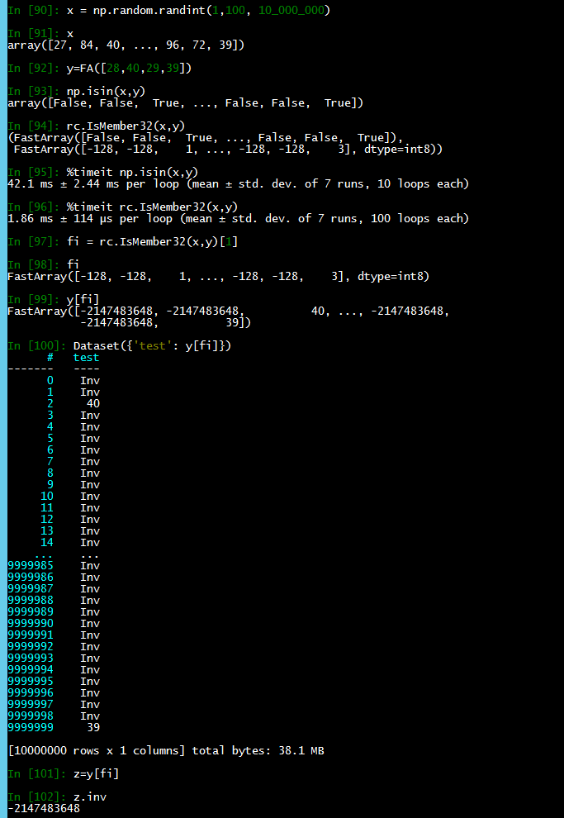
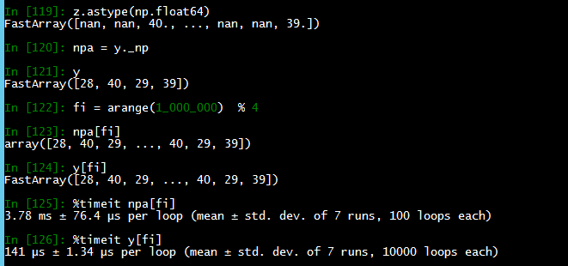
Hashing speed plus invalids and fancy indexing
Very common big array, 99 uniques
compare ismember to np.isin
ismember also returns fancy index
20x faster with more information
fancy idx understand invalids
Dataset/Frame understands also
astype understands invalids
25x faster with invalid capability

Slide 22
Subclass before creating a new dtype
Example: Datetime or ipv4 class
We have DateTimeNano, TimeSpan, Date, DateSpan classes
Date class is int32, days since epoch and is timezone agnostic
Subtracting two Dates produces a DateSpan
Also based on int32
Substracting two Times produces a TimeSpan
Can be EITHER int64 or float64 based
Each has pros and cons
Is that 5 new dtypes? Now a TimeSeries class.. 6 new dtypes? Ipv4 – 7 new dtypes? When does it end?
Rather just subclass
class Date(FastArray, otherclass):
def __new__(cls, arr, ..):
return arr.view(Date)
Use isinstance() to detect, may need centralized Class registry (we have a TypeRegister)
No new ufunc loops required:
If I want to add 3 to DateTimeNano to add 3 nanoseconds, just +3
Hits sped up vectorized addition code – no new work
No switch(dtype):
case int64:
case datetime64: ← no need to add this new dtype everywhere anymore

Slide 23
Ledger
Records all operations, can time them
Can see when upcasting occurs, which routines take longest, order op operations, how many threads used
Built into portable C code (so all languages can use)
Useful for debugging performance (espec due to C code hiding from most python profilers)
Similar info with Recycler

Slide 24
New dtypes
Variable length strings
Bitmask Boolean
Otherwise subclass from common dtypes
Use isinstance() checks
May want central “TypeRegister” to hold all known types
Class has to know how to save itself and reload itself so can be serialized to any file format
Class has to know how to display itself, right/left justification or long short display format, strftime format, precision, ipv4 etc.

Slide 25
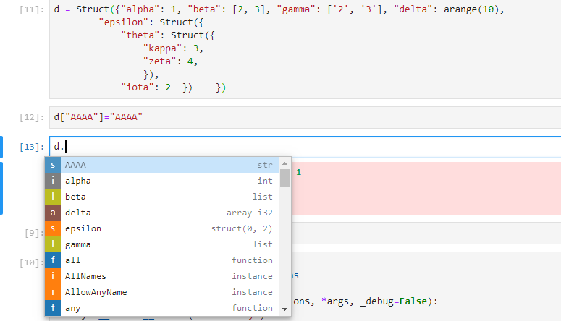
Display/Serialization Hooks
Known __ attributes to get/set meta data for serialization
Hooks to help with autocomplete
Or other display – left justified, abbreviated, etc.

